Slide 1
WEB FUNDAMENTALS PROJECT
. How does the web work?
. What do you need to be a web developer?
. What is the role of a web developer.
SALMA CHARFI

Slide 2
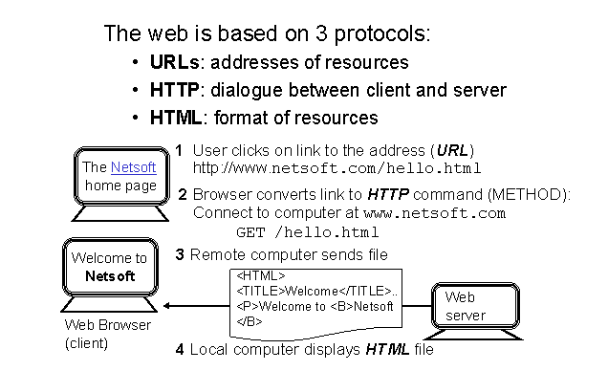
1. HOW DOES THE WEB WOKS?

Slide 3
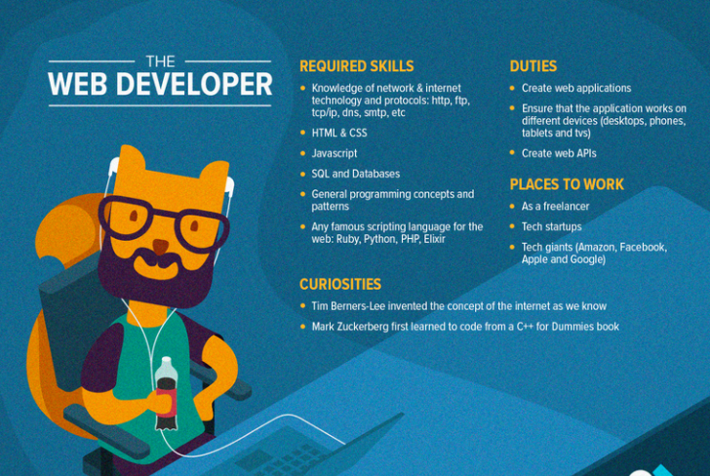
2. What do you need to be a web developer?

Slide 4
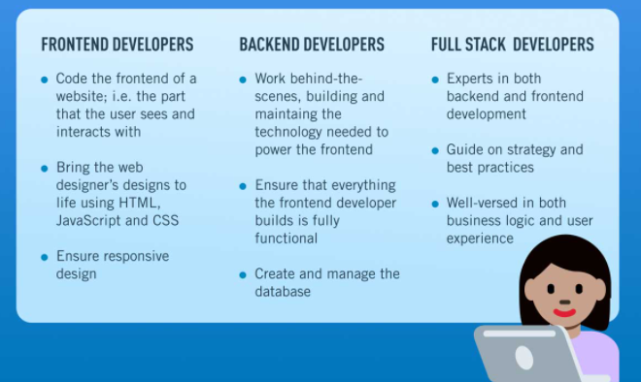
3. What is the role of a web developer

